Slide 1
Assessing the Impact of Immigration on Inflation Across Canadian Provinces (2010–2025)
Darren Andrew Dcunha
PO11015
MPS Data Science

Slide 2
Introduction
This project examines whether immigration influences inflation across Canadian provinces from 2010–2025.
Data was collected from Statistics Canada, covering CPI components, population, immigration/NPR flows, housing supply, and interest rates.
After building a unified provincial dataset, we conducted EDA, feature engineering, and multiple modeling frameworks to test the strength and stability of the immigration–inflation relationship.
Models evaluated include: Linear Regression, Lasso, Ridge, XGBoost, ARIMAX, and VARMAX.
The goal is to determine whether immigration provides predictive value for inflation or whether other macroeconomic forces—such as interest rates and housing supply—play a more significant role.

Slide 3
Data Collection & Merge
Data Sources
  CPI (All-items, Shelter)
  Population
  Immigration & NPR
  Housing Starts
  Interprovincial Migration
  Policy Rate
Standardization
  Converted all datasets to quarterly (Q-end)
  Cleaned province labels; removed territories
  Ensured consistent date formats.
Merge Logic
  Merge key: province + quarter_date
  Sequential merge:
  CPI → Population → Immigration/NPR → Housing → Migration → Interest Rate
  Dropped NA rows created from mismatches
Final Output
  Unified provincial dataset (2010–2025)
  Ready for EDA, feature engineering, and modeling

Slide 4
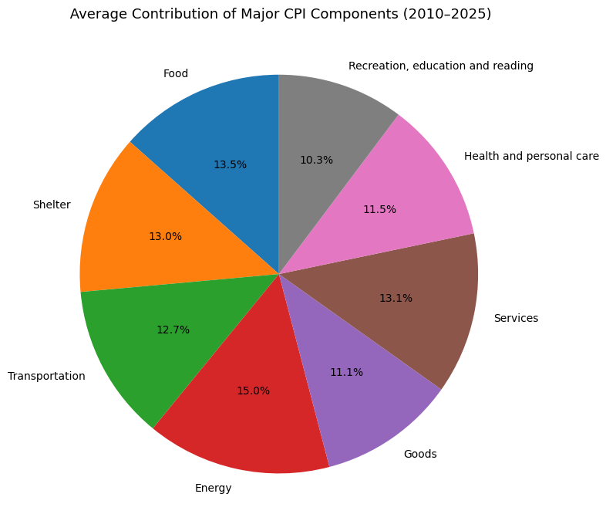
Average Contribution of CPI Components (2010–2025)
Energy is the largest driver (15%), making CPI highly sensitive to oil and fuel shocks.
Shelter, Services, and Transportation together dominate inflation, accounting for nearly 40% of the basket.
Food and Shelter contribute similarly (~13%), showing persistent pressure on essential household costs.
Recreation, Education, and Health have smaller shares, indicating they play a limited role in overall inflation movement.

Slide 5
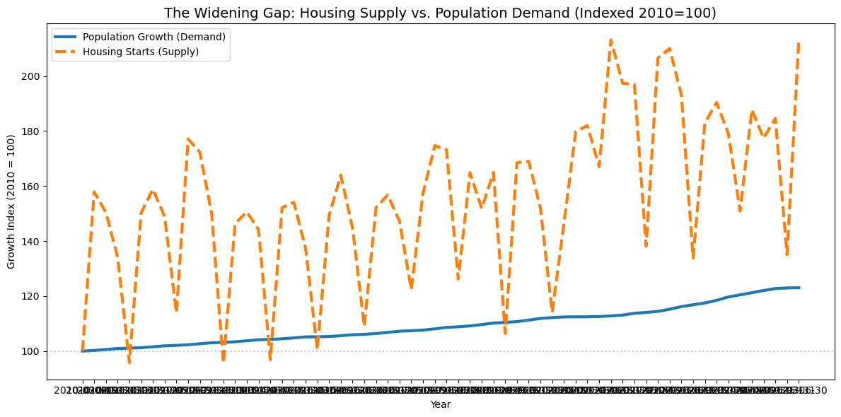
Housing Supply Is Not Keeping Up With Population Demand (2010–2025)
Population grows steadily, showing consistent upward pressure on housing demand.
Housing starts are highly volatile, with sharp ups and downs and no stable long-term upward trend.
The gap between demand and supply widens over time, indicating that new construction is not matching population growth.
This persistent imbalance contributes to rising shelter costs, especially in provinces experiencing strong migration inflows.

Slide 6
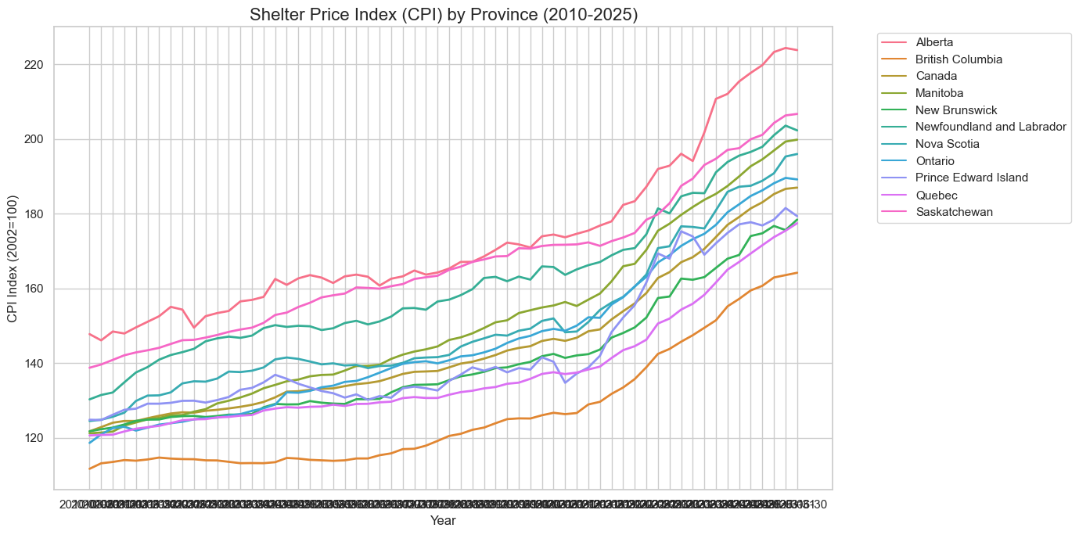
Shelter Inflation Has Accelerated Across All Provinces (2010–2025)
Shelter prices rise sharply after 2020 across all provinces, indicating a nationwide housing affordability pressure.
Alberta, Saskatchewan, and parts of Atlantic Canada show the steepest increases, reflecting regions with strong population inflows and limited housing supply.
British Columbia remains the lowest but still trends upward, showing that even mature housing markets face sustained inflation.
The divergence between provinces widens over time, highlighting increasing regional inequality in housing costs.

Slide 7
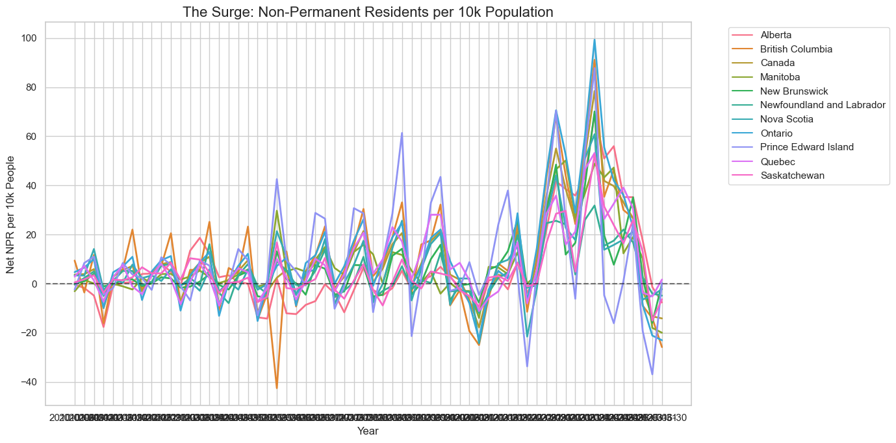
The NPR Surge: A Sharp Post-2020 Increase Across All Provinces
Non-Permanent Resident (NPR) levels jump dramatically after 2020, far above historical norms for nearly every province.
All provinces follow the same spike-and-decline pattern, indicating that the surge was a national shock, not a regional phenomenon.
Volatility increases significantly, with much larger swings compared to the stable pre-2020 period.
The magnitude of the surge (up to 100 NPRs per 10k people) represents a structural break, which helps explain why many models fail to generalize across the 2020–2023 period.

Slide 8
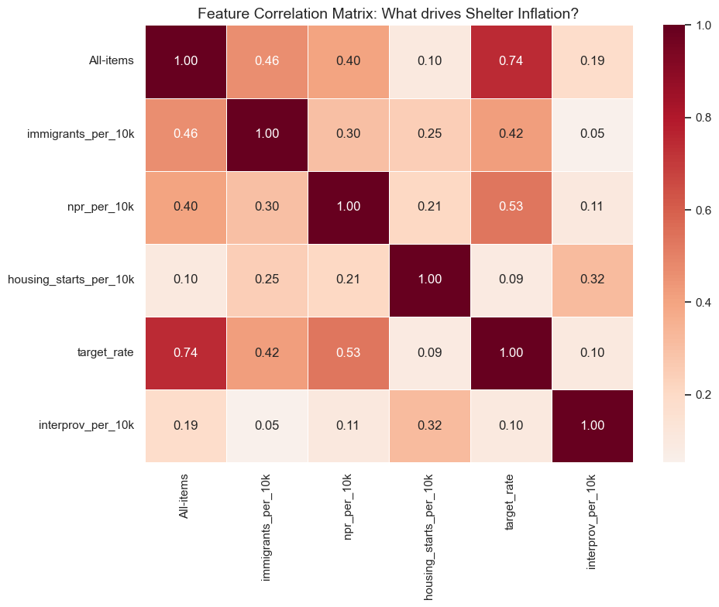
Correlation Insights
Interest rates have the strongest correlation with Shelter (0.74), indicating monetary policy is the dominant driver of shelter costs.
Immigration and NPR flows show only moderate correlations (0.30–0.46), suggesting limited direct influence on shelter inflation.
Housing starts per 10k show very weak correlations (≈0.10–0.21), reinforcing that new construction effects are slow and diffuse.
Interprovincial migration has almost no relationship with Shelter, meaning internal mobility does not strongly impact provincial housing inflation.
Overall, monetary policy and broad inflation trends outperform migration variables, aligning with modeling results that show weak predictive power for immigration-based features.

Slide 9
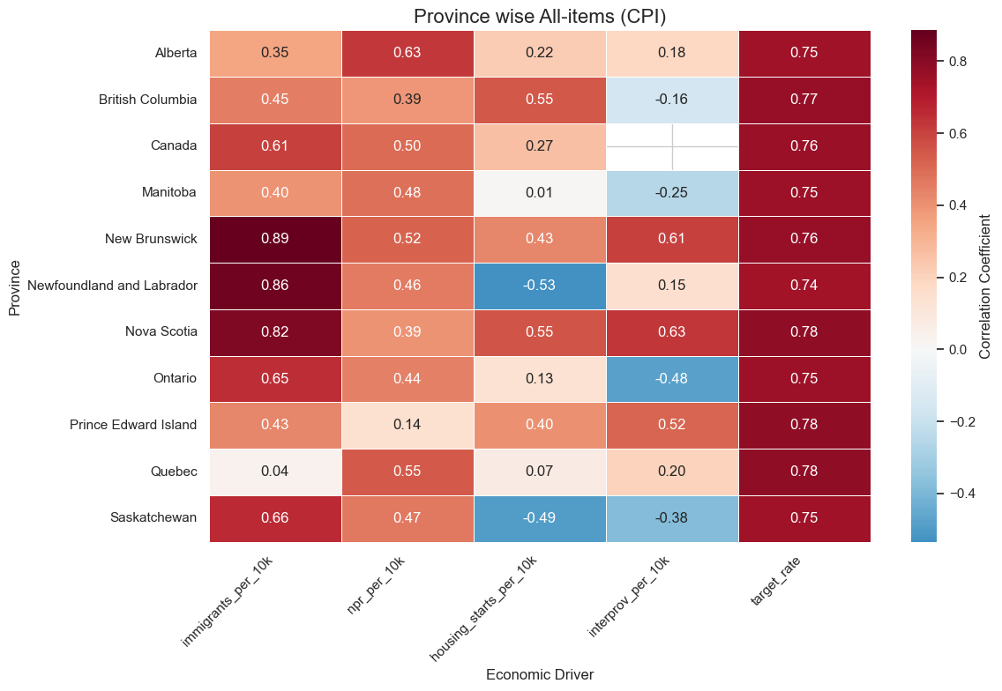
A Province-by-Province Correlation View
Interest rates are the strongest and most consistent driver, with correlations around 0.74–0.78 in every province.
Atlantic provinces show very strong links between immigration and inflation, especially New Brunswick (0.89), Newfoundland & Labrador (0.86), and Nova Scotia (0.82).
Large provinces (Ontario, BC, Canada) show moderate immigration correlations (0.45–0.65), indicating weaker demographic pressure relative to housing supply and monetary policy.
Housing starts generally show weak or negative correlations, suggesting supply responses lag far behind inflation dynamics.
Interprovincial migration shows mixed patterns, negative in some provinces (Ontario, Manitoba, Saskatchewan) and weak elsewhere, meaning internal mobility does not uniformly drive inflation.
Overall, monetary policy dominates inflation patterns, while migration effects vary widely by province and are strongest in smaller Atlantic regions.

Slide 10
Feature Engineering Framework
Key Feature Groups
Growth Rates (YoY): population, immigration, NPR, housing starts
Per-Capita Ratios: immigrants per 10k, NPR per 10k, housing starts per 10k
Pressure Ratio: (immigrants + NPR) ÷ housing starts
Lagged Variables: 2-quarter lags for migration & rates, 4-quarter lag for housing supply
Purpose
Capture demand–supply imbalance
Reflect real economic delays
Enable models to test whether migration and housing dynamics influence inflation

Slide 11
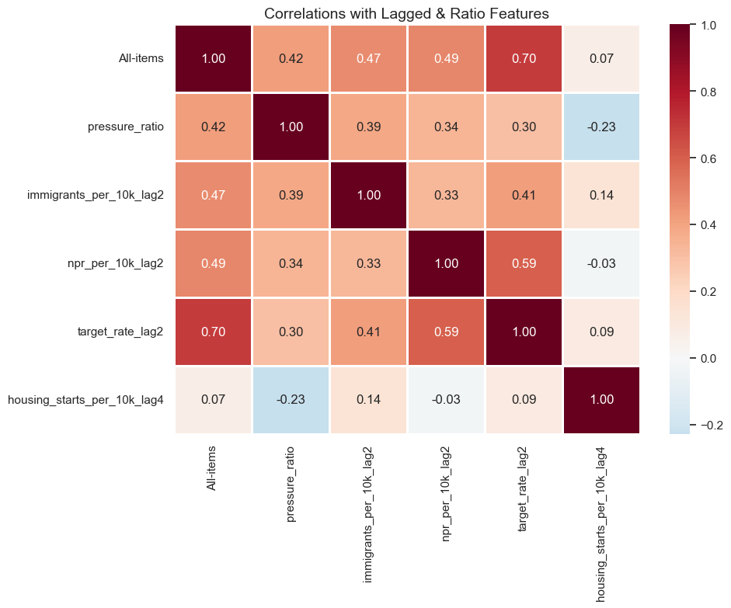
Engineered Features Correlation Insights
Interest rates (lagged 2 quarters) show the strongest correlation with inflation (0.70), confirming monetary policy as the most influential driver.
Lagged immigration and NPR variables show moderate correlations (0.33–0.49), indicating limited and unstable predictive value.
Pressure ratio (newcomers per housing start) has only a mild correlation (0.42), suggesting that supply–demand imbalance alone does not strongly explain inflation.
Lagged housing starts show very weak or negative correlations, reinforcing that new housing supply impacts inflation slowly and inconsistently.
Overall, engineered migration features do not outperform macro variables, supporting the conclusion that immigration is not a significant predictor of inflation in this dataset.

Slide 12
Linear regression
Province | Base Train R² | Base Test R² | Exog Train R² | Exog Test R² | Δ R² (Improvement)
Prince Edward Island | 0.508 | -168.352 | 0.584 | -133.252 | +35.10
Ontario | 0.168 | -51.563 | 0.367 | -25.497 | +26.07
Canada (National) | 0.093 | -46.513 | 0.235 | -25.452 | +21.06
Newfoundland & Labrador | 0.448 | -18.835 | 0.698 | -1.693 | +17.14
British Columbia | 0.498 | -36.340 | 0.649 | -24.815 | +11.52
Alberta | 0.324 | -26.212 | 0.371 | -16.289 | +9.92
New Brunswick | 0.792 | -14.642 | 0.841 | -7.530 | +7.11
Nova Scotia | 0.722 | -19.241 | 0.818 | -13.349 | +5.89
Saskatchewan | 0.767 | -47.655 | 0.778 | -46.824 | +0.83
Quebec | 0.318 | -27.016 | 0.523 | -40.533 | –13.52
Manitoba | 0.075 | -83.490 | 0.111 | -99.756 | –16.27
Exogenous Features Improve the Model — but Only In-Sample
  Adding immigration + housing features raises Train R² in almost all provinces.
  Biggest gains: PEI, Ontario, Canada, Newfoundland.
Test R² Remains Negative Across All Provinces
  Every province still shows negative Test R², meaning the model performs worse than a baseline average.
The model fails to generalize, especially after 2020.
Large Improvements Don’t Translate to Predictive Power
  Example: PEI improves by +35 R², but Test R² is still –133 → completely unreliable.
  Highlights overfitting and unstable relationships.
Some Provinces Get Worse with Immigration Features
  Quebec and Manitoba show lower predictive performance after adding exogenous variables.
  Immigration features add noise, not signal in these provinces.

Slide 13
Regularization - LASSO
Province | Base Train R² | Base Test R² | Exog Features Selected | Exog Train R² | Exog Test R² | ΔR² | Best Alpha
Manitoba | 0.089 | -286.185 | 0 | 0.000 | -132.878 | +153.31 | 1.5179
Newfoundland & Labrador | 0.476 | -120.923 | 8 | 0.756 | -27.936 | +92.99 | 0.0544
Prince Edward Island | 0.578 | -211.164 | 3 | 0.487 | -126.115 | +85.05 | 1.3565
Canada | 0.099 | -116.510 | 1 | 0.000 | -65.987 | +50.52 | 2.2285
Quebec | 0.306 | -103.193 | 0 | 0.000 | -56.022 | +47.17 | 2.6612
Saskatchewan | 0.711 | -204.490 | 5 | 0.715 | -157.566 | +46.92 | 0.5064
Alberta | 0.380 | -106.146 | 1 | 0.130 | -62.404 | +43.74 | 3.4805
British Columbia | 0.593 | -82.159 | 3 | 0.514 | -53.541 | +28.62 | 1.7532
Ontario | 0.191 | -83.148 | 0 | 0.000 | -68.219 | +14.93 | 4.0176
Nova Scotia | 0.787 | -47.669 | 2 | 0.821 | -39.031 | +8.64 | 0.5551
New Brunswick | 0.762 | -42.981 | 2 | 0.786 | -35.980 | +7.00 | 0.4531
LASSO improves the model in-sample, but Test R² remains negative in all provinces.
Several provinces have 0 selected features, showing weak predictive signal from immigration variables.
Improvements reflect overfitting, not true forecasting strength.
Overall, immigration and housing features do not provide reliable predictive power for All-items inflation.

Slide 14
Regularization - Ridge
Province | Base Train R² | Base Test R² | Exog Train R² | Exog Test R² | ΔR² | Best Alpha
Manitoba | 0.089 | -286.185 | 0.001 | -133.322 | +152.86 | 10000.0000
Newfoundland & Labrador | 0.476 | -120.923 | 0.731 | -28.296 | +92.63 | 14.3845
Canada | 0.099 | -116.510 | 0.094 | -60.060 | +56.45 | 263.6651
Alberta | 0.380 | -106.146 | 0.147 | -60.988 | +45.16 | 263.6651
Prince Edward Island | 0.578 | -211.164 | 0.517 | -177.097 | +34.07 | 29.7635
Ontario | 0.191 | -83.148 | 0.244 | -55.139 | +28.01 | 127.4275
Quebec | 0.306 | -103.193 | 0.433 | -77.622 | +25.57 | 29.7635
Saskatchewan | 0.711 | -204.490 | 0.732 | -185.687 | +18.80 | 0.0100
British Columbia | 0.593 | -82.159 | 0.650 | -66.701 | +15.46 | 0.7848
New Brunswick | 0.762 | -42.981 | 0.785 | -28.087 | +14.89 | 6.9519
Nova Scotia | 0.787 | -47.669 | 0.830 | -39.595 | +8.07 | 6.9519
Ridge uses all features in every province, confirming strong multicollinearity across predictors.
Train R² improves substantially (e.g., Manitoba +152, Newfoundland +92), but Test R² remains negative everywhere.
The model fits historical data well but fails to generalize, indicating structural breaks after 2020.
Immigration and housing variables still do not provide stable predictive power even with regularization.
Ridge reduces overfitting slightly compared to Linear and Lasso, but forecast accuracy does not improve.

Slide 15
XGBoost
Province | Base Train R² | Base Test R² | Exog Train R² | Exog Test R² | ΔR²
Newfoundland & Labrador | 0.720 | -94.749 | 1.000 | -70.964 | +23.78
Manitoba | 0.999 | -84.197 | 1.000 | -77.264 | +6.93
Saskatchewan | 0.971 | -92.904 | 0.994 | -88.003 | +4.90
Canada | 0.899 | -44.742 | 0.972 | -40.117 | +4.62
British Columbia | 0.999 | -39.284 | 0.999 | -37.067 | +2.22
Ontario | 0.755 | -55.169 | 0.757 | -53.186 | +1.98
Alberta | 1.000 | -69.164 | 0.968 | -67.212 | +1.95
Quebec | 0.742 | -45.571 | 0.746 | -45.868 | –0.30
Nova Scotia | 1.000 | -46.751 | 1.000 | -47.186 | –0.43
Prince Edward Island | 0.716 | -117.988 | 0.713 | -119.830 | –1.84
New Brunswick | 1.000 | -47.681 | 0.974 | -50.906 | –3.22
XGBoost achieves very high Train R² (up to 1.00), showing it fits historical data extremely well.
All Test R² values remain negative, indicating the model cannot generalize to unseen data.
Exogenous features (immigration, NPR, housing pressure) give small improvements but never produce positive Test R².
Several provinces perform worse after adding these features, showing they add noise rather than predictive signal.
Overall, even advanced nonlinear modeling shows no stable evidence that immigration or housing features predict inflation.

Slide 16
ARIMAX
Province | Train R² | Test R² | Test RMSE | Observations | Model Order
British Columbia | -2.029 | 0.845 | 1.648 | 58 | (1,1,0)
Canada (National) | -1.518 | 0.752 | 2.219 | 58 | (1,1,0)
Saskatchewan | -2.056 | 0.600 | 2.643 | 58 | (1,1,0)
Manitoba | -0.366 | -0.560 | 6.291 | 58 | (1,1,0)
Ontario | -0.683 | -1.257 | 6.300 | 58 | (1,1,0)
Quebec | -3.292 | -1.928 | 8.679 | 58 | (1,1,0)
New Brunswick | -1.821 | -4.217 | 9.955 | 58 | (1,1,0)
Alberta | -1.802 | -8.070 | 15.009 | 58 | (1,1,0)
Nova Scotia | -1.520 | -8.350 | 14.208 | 58 | (1,1,0)
Newfoundland & Labrador | -1.512 | -9.156 | 12.921 | 58 | (1,1,0)
Prince Edward Island | -1.214 | -17.558 | 11.480 | 58 | (1,1,0)
Only three regions (BC, Canada, Saskatchewan) achieve positive Test R², meaning ARIMAX works only in large, stable markets.
Most provinces show negative Test R², indicating ARIMAX cannot capture the structural shocks in Shelter inflation.
Train R² is negative across all provinces, showing the base ARIMA structure fits poorly even in-sample.
Smaller and more volatile provinces (PEI, NL, Alberta) show very poor forecasting, likely due to extreme post-2020 housing shocks.
Overall, ARIMAX demonstrates that migration and Shelter dynamics are not well-explained by linear time-series models under structural breaks.

Slide 17
VARMAX
Province | Train R² | Test R² | Test RMSE | Observations
Canada | 0.425 | 0.127 | 0.434 | 57
British Columbia | 0.190 | -0.015 | 0.431 | 57
Quebec | 0.398 | -0.026 | 0.523 | 57
New Brunswick | 0.185 | -0.034 | 0.723 | 57
Newfoundland & Labrador | 0.182 | -0.047 | 0.642 | 57
Saskatchewan | 0.413 | -0.063 | 0.578 | 57
Prince Edward Island | 0.216 | -0.123 | 0.908 | 57
Ontario | 0.428 | -0.125 | 0.493 | 57
Alberta | 0.102 | -0.158 | 0.636 | 57
Nova Scotia | 0.232 | -0.432 | 0.899 | 57
Manitoba | 0.356 | -0.441 | 0.838 | 57
VARMAX provides only one positive Test R² (Canada = 0.127), showing limited forecasting ability.
Most provinces still have negative Test R², meaning multivariate dynamics do not generalize well out-of-sample.
Train R² values are moderate (0.18–0.43), indicating the model struggles even in fitting historical relationships.
Structural breaks after 2020 likely disrupt the joint behavior of inflation, immigration, housing, and interest rates, making VARMAX unstable.
Overall, VARMAX shows no strong evidence that adding immigration and housing supply variables improves inflation forecasting.

Slide 18
Project Insights
Interest rates are the strongest and most consistent driver of inflation, outperforming all migration and housing variables.
Immigration and NPR variables show correlations but lack predictive power—all models fail to generalize out-of-sample.
Housing supply lags behind population growth, contributing to Shelter inflation but not strongly to All-items inflation.
Structural breaks after 2020 (NPR surge, rate hikes, supply shocks) disrupt traditional model behavior across provinces.
Advanced models (XGBoost, ARIMAX, VARMAX) do not yield stable improvements, confirming that the immigration–inflation relationship is weak and unstable.

Slide 19
Future Work
Explore nonlinear, regime-switching models to better capture structural breaks.
Incorporate rental vacancy rates, construction timelines, wage data, and regional market indicators.
Use panel-data models (fixed effects, random effects) for cross-province comparisons.
Assess whether machine learning with time-series cross-validation improves generalization.

Slide 20
Conclusions
Immigration-related features improve training R², but test R² remains negative across nearly all provinces and models → no generalizable predictive power.
Interest rates show the strongest and most stable relationship with inflation, far stronger than any migration variable.
Shelter inflation has only moderate links to immigration, meaning migration adds demand pressure but is not a primary driver of overall inflation.
NPR surges after 2021 created major structural breaks, preventing models from learning stable relationships.
Correlations seen in small provinces do not translate to forecasting ability, indicating they are not causal inflation mechanisms.

Slide 21
Final Statement
Evidence to date shows no reliable or consistent influence of immigration on inflation in Canada.
We will continue testing more advanced, nonlinear, and regime-switching models to ensure no hidden effects are overlooked.
A final conclusion will be drawn only after exploring all alternative modeling frameworks.

